Slide 1
COMP 491/L. Senior Design
Project II and Lab (2/1)
Spring 2025
Final Project
Presentation
FitGenius Mobile App
Team #3

Slide 2
Meet The Team!
Sergio
Garcia
Emanuel
Diaz
Arpa Hakopian
Mirna
Farahat
Isai
Flores
Project Lead:
Team Members:
Notes:
Sergio, emanuel, arpa, mirna, isai

Slide 3
01
Goals and Outcomes
Key Objectives and Outcomes Achieved,
Notes:
Before we get into the technical details, we want to take a step back and talk about what we set out to achieve — and why we built FitGenius in the first place.
We started this project by identifying a problem that’s common in many fitness apps: they’re often generic, lack motivation, and don’t adapt to the individual. That’s where FitGenius comes in.

Slide 4

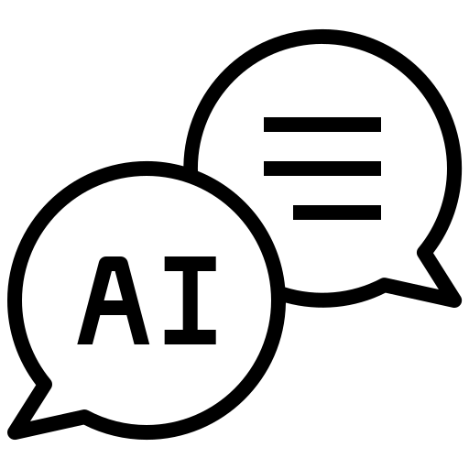

Goals and Outcomes
Key Objectives:
Personalize fitness tracking and guidance
Integrate HealthKit to gather user data
Motivate users through avatar-based rewards
Outcomes Achieved:
HealthKit integration with real-time data
AI chatbot with personalized fitness advice
Unlockable avatar features tied to milestones
Notes:
Our goal with FitGenius was to address something we’ve all probably experienced at some point: unmotivating, one-size-fits-all fitness apps.
We wanted to build something that feels personal — like having a virtual coach that actually knows you, your progress, and your goals.
So one of our first key objectives was to integrate Apple HealthKit, allowing us to gather real data like steps walked and calories burned. With the user’s permission, we use this data to help tailor their experience inside the app.
The second objective was the AI chatbot — which we designed to be more than just a bot. It remembers the user's metrics and provides personalized workout and meal suggestions, along with encouragement. We made sure it only responds to health- and fitness-related questions to keep the experience focused and safe.
Finally, we wanted to motivate users through gamification. As users complete workout routines or reach fitness goals, they unlock new features for their personal avatar. This adds a fun, visual layer of progress — and gives users something to look forward to.
In terms of outcomes, we’re really proud of how far we got. We successfully implemented HealthKit, the chatbot works reliably and understands user context, and the avatar system looks great — with unlocked items highlighted in gold when earned.
Altogether, these features come together to deliver a personalized fitness experience that not only guides users, but keeps them motivated and actively engaged in their goals.

Slide 5
02
Development Process

Slide 6
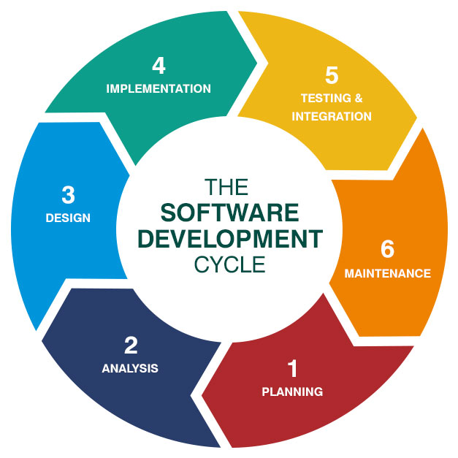
Journey Overview
Stage | Description
1 | Identified the need for a personalized fitness app powered by AI.
2 | Gathered user requirements—goals, metrics, equipment, etc.—and Firebase setup.
3 | Created UI/UX wireframes, chatbot flow, and Firestore schema.
4 | Built SwiftUI views, integrated AI, Firebase, HealthKit, and reward systems.
5 | Debugged modules, refined AI parsing, verified reward logic and persistence.
6 | Ongoing improvements: syncing, UI polish, avatar systems, weekly rollovers.

Slide 7


Challenges Faced
User Authentication and Data Storage (Firebase + Firestore)
Debugging early Firebase connection issues
Learning to restrict Firestore access per user
Fixing syncing issues between Firebase Auth and Firestore
Fixing UI bugs with disappearing text fields

Slide 8
Solutions
User Authentication and Data Storage (Firebase + Firestore)
Identified that macOS sandboxing blocked Firebase and switched to iOS for further testing
Updated Firebase security rules so users can only access their own data
Synced user data only after confirming account creation and retrieving user ID
Resolved UI bugs by replacing the default TextField style with custom frames

Slide 9

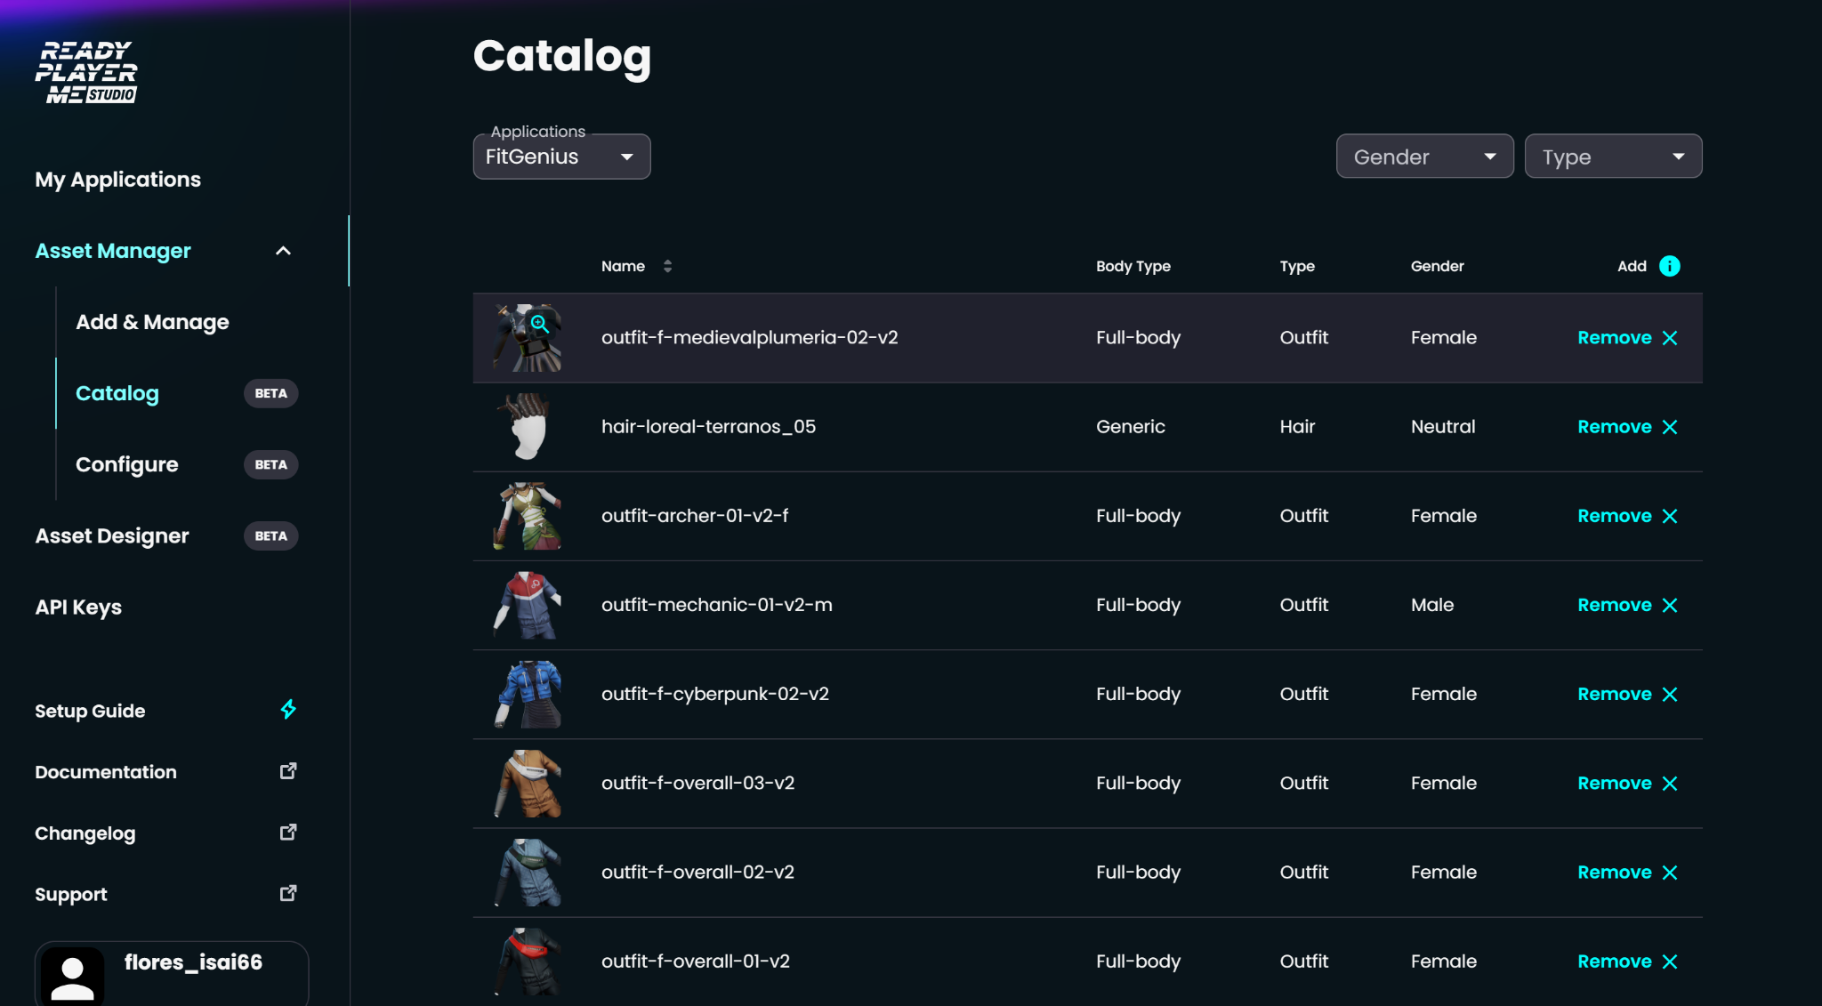
Challenges Faced
Avatar Creation
Learning how to use the Ready Player Me API
Learning how models work in ios
Not having too much documentation
The documentation that was available wasn’t detailed enough
A lot of trial and error with API calls
A lot of the code Ready Player Me provided was a bit outdated
Having to come up with different ways to show the avatars in ios
Notes:
Gltf or usdz

Slide 10
Solutions
Avatar Creation
A lot of trial and error of trying different ways of implementing the Ready Player Me API
Refactoring the provided code from Ready Player Me
Instead of showing a 3d model in the home page a png of the avatar was put instead

Slide 11
Challenges Faced
AI Chatbot & Workout Plan
How do we convert the AI’s natural language into an interactable workout plan?
Initial AI responses were inconsistent, overly verbose, and hard to parse.
Needed a structured way to create usable, trackable workout modules in the app.

Slide 12
Solutions
AI Chatbot & Workout Plan
Initially used string searching → too inconsistent and complex.
Switched to structured AI prompts with hidden JSON (day, exercise, sets, reps, rest).
Hidden JSON allowed reliable parsing into app components.
Built a parser to turn AI output into SwiftUI views.
Exercises shown as tappable checkboxes for tracking.
Synced progress with Firestore for persistence.

Slide 13
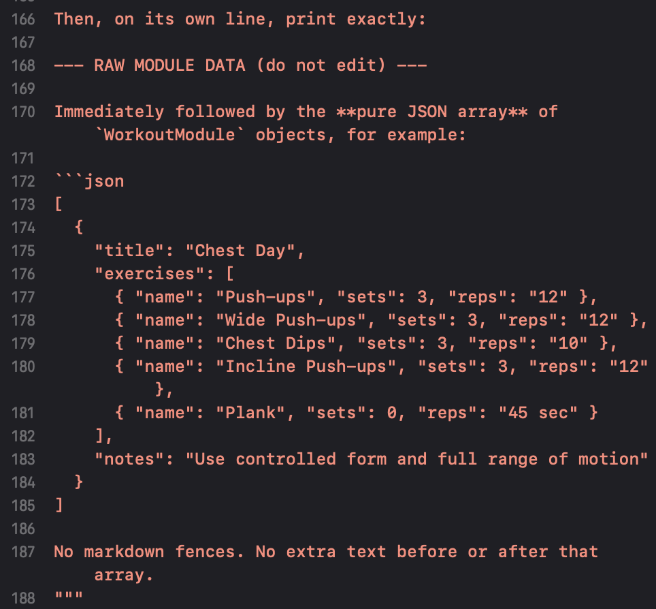
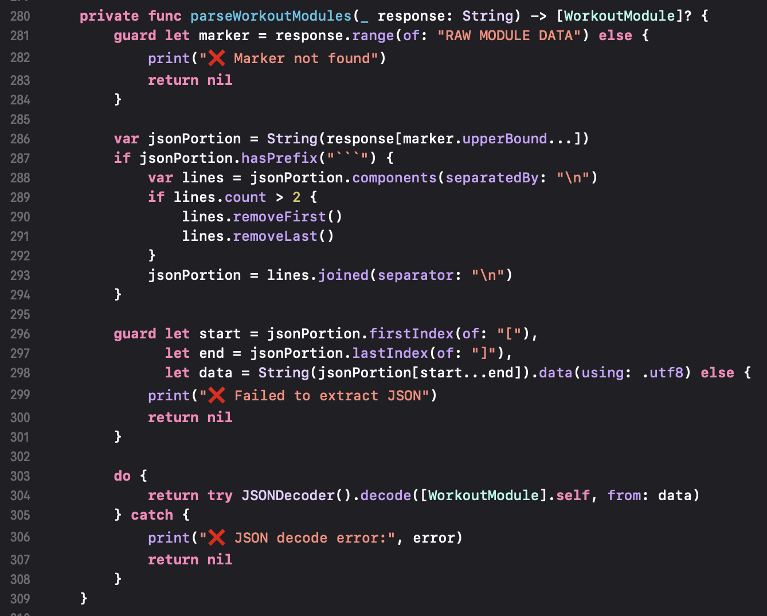
Challenges Faced
AI Chatbot & Workout Plan

Slide 14
03
Lessons Learned

Slide 15
Lessons Learned
Access to resources makes a BIG impact…ie Apple Developer Program, OpenAI
Gained a sense of the scale of project we can accomplish in a limited amount of time
Working with IOS means jumping through hoops
Always overestimate time dedicated to refactoring
Communication as a team was our strong suit

Slide 16
Recommendations
Don’t be afraid of taking on new challenges
Be mindful of time constraints
Utilize as many resources as possible
Chances are whatever issue you’re having someone else has also had and documented online
Communication is key!

Slide 17
04
Deliverables
Final Build, Sourced Code, and more
Notes:
As we approached the end of our development cycle, we wanted to ensure that every aspect of the project — from code to documentation — was complete AND polished
These deliverables reflect everything we’ve built, tested, and refined throughout the development of FitGenius.

Slide 18
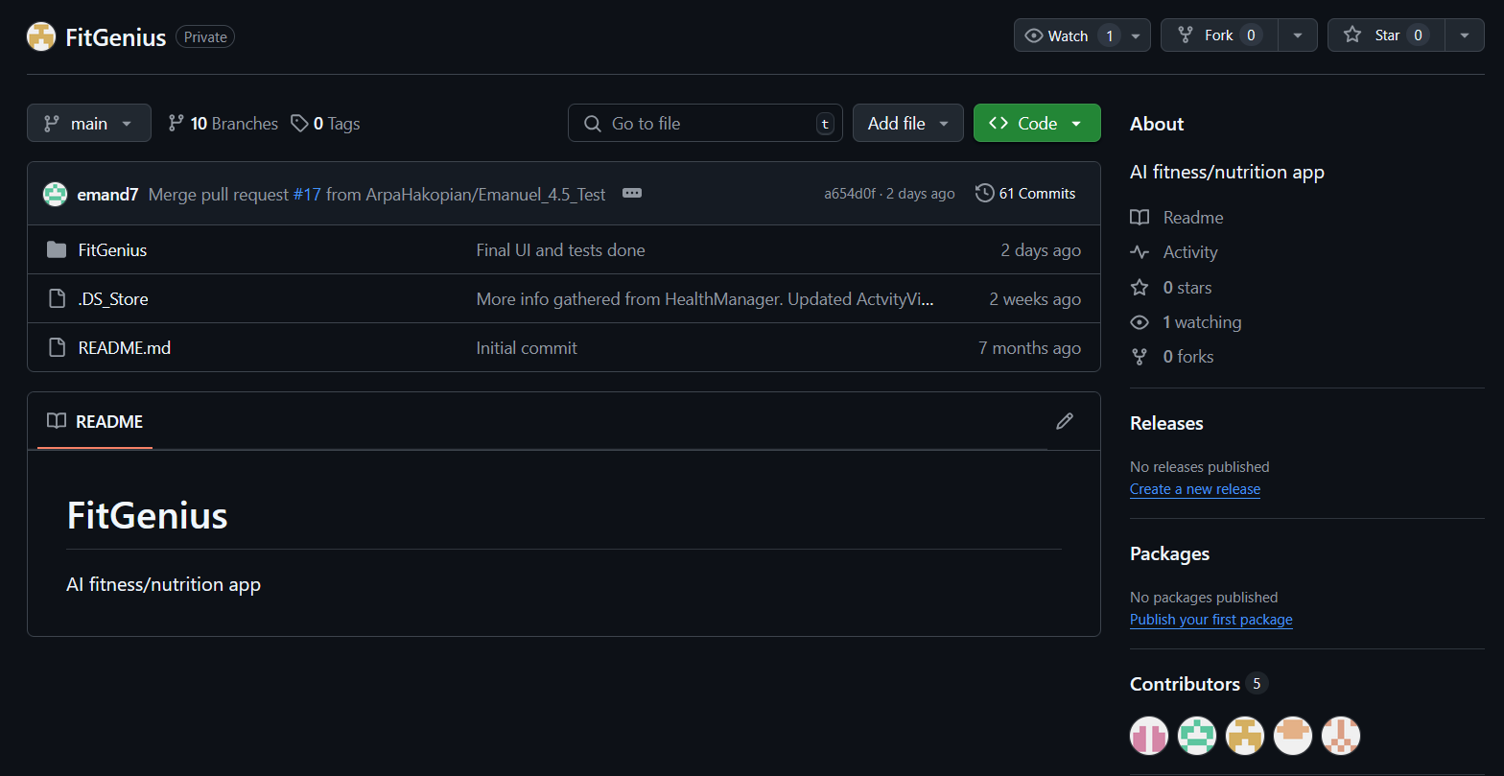
✔ Source Code
Fully implemented and version-controlled on GitHub
Aligned with team’s coding standards
Notes:
For our final deliverables, we ensured that every required component of the FitGenius project was completed, reviewed, and aligned with our final implementation.
First, the source code is fully implemented and version-controlled using GitHub. It follows our team’s coding standards and includes clear commit messages, well-organized folders, and documentation throughout the codebase.

Slide 19
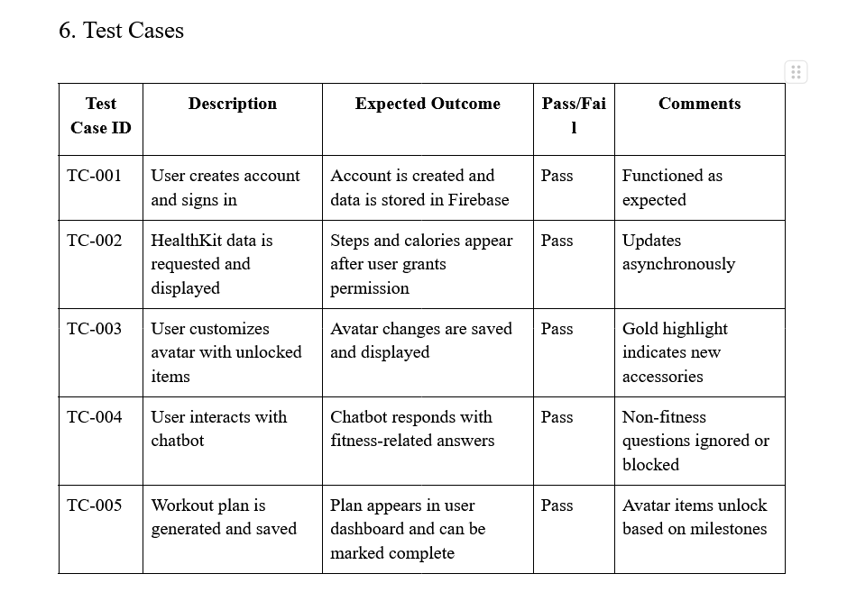
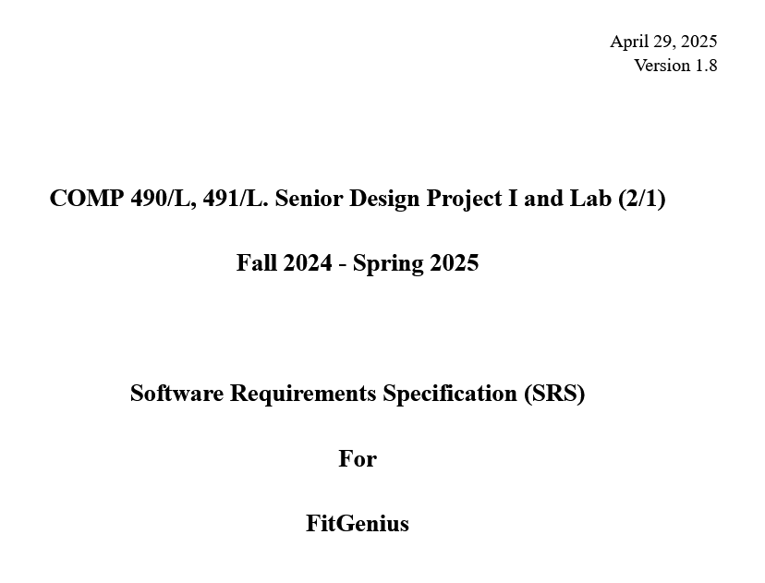
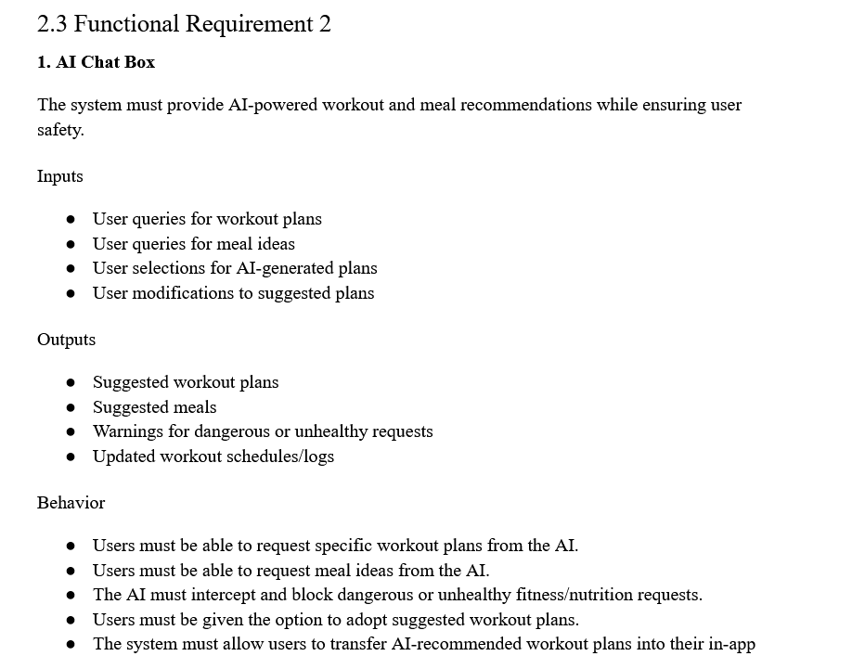
✔ User Acceptance Test Report
Completed and submitted in Word format
✔ Final Software Build
Fully functional and ready for internal deployment
Meets all project requirements
✔ Updated Documentation
Includes Project Plan, Requirements, Design, and UAT Test Report
Notes:
Our UAT Report is finalized. It outlines our testing process, success criteria, issue logs, and user feedback — all of which reflect the real-world performance of our app.
The final software build is complete, fully functional, and ready for internal deployment. It meets all the project’s original requirements, including chatbot integration, HealthKit syncing, and milestone-based avatar unlocks.

Slide 20
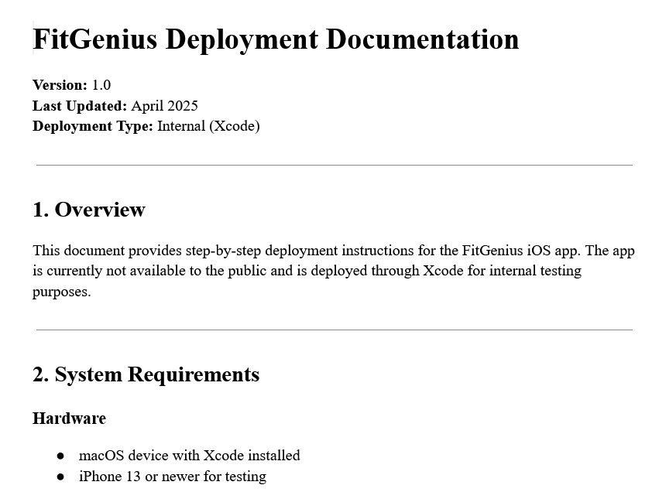
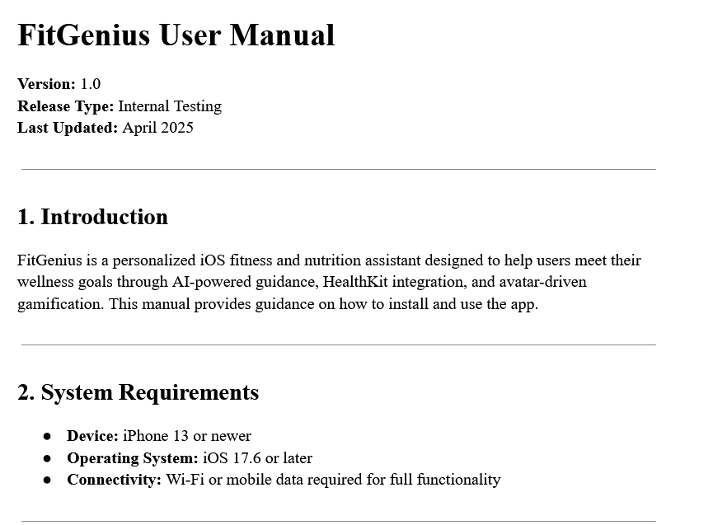
✔ Deployment Documentation
Includes system requirements and installation steps
✔ User Manual
Step-by-step instructions and troubleshooting guide
Notes:
We’ve also created deployment documentation with detailed installation steps, system requirements, and configuration notes for internal testers using Xcode.
Our User Manual provides clear, step-by-step guidance for end users, covering everything from account setup and avatar customization to troubleshooting common issues.
Finally, we went back and revised all of our previous presentations to match the final outcomes of the project. We wanted to make sure that everything we've shared — whether in a pitch, a status update, or a milestone review — is fully consistent with the completed version of FitGenius.

Slide 21
05
Demo
FitGenius App

Slide 22
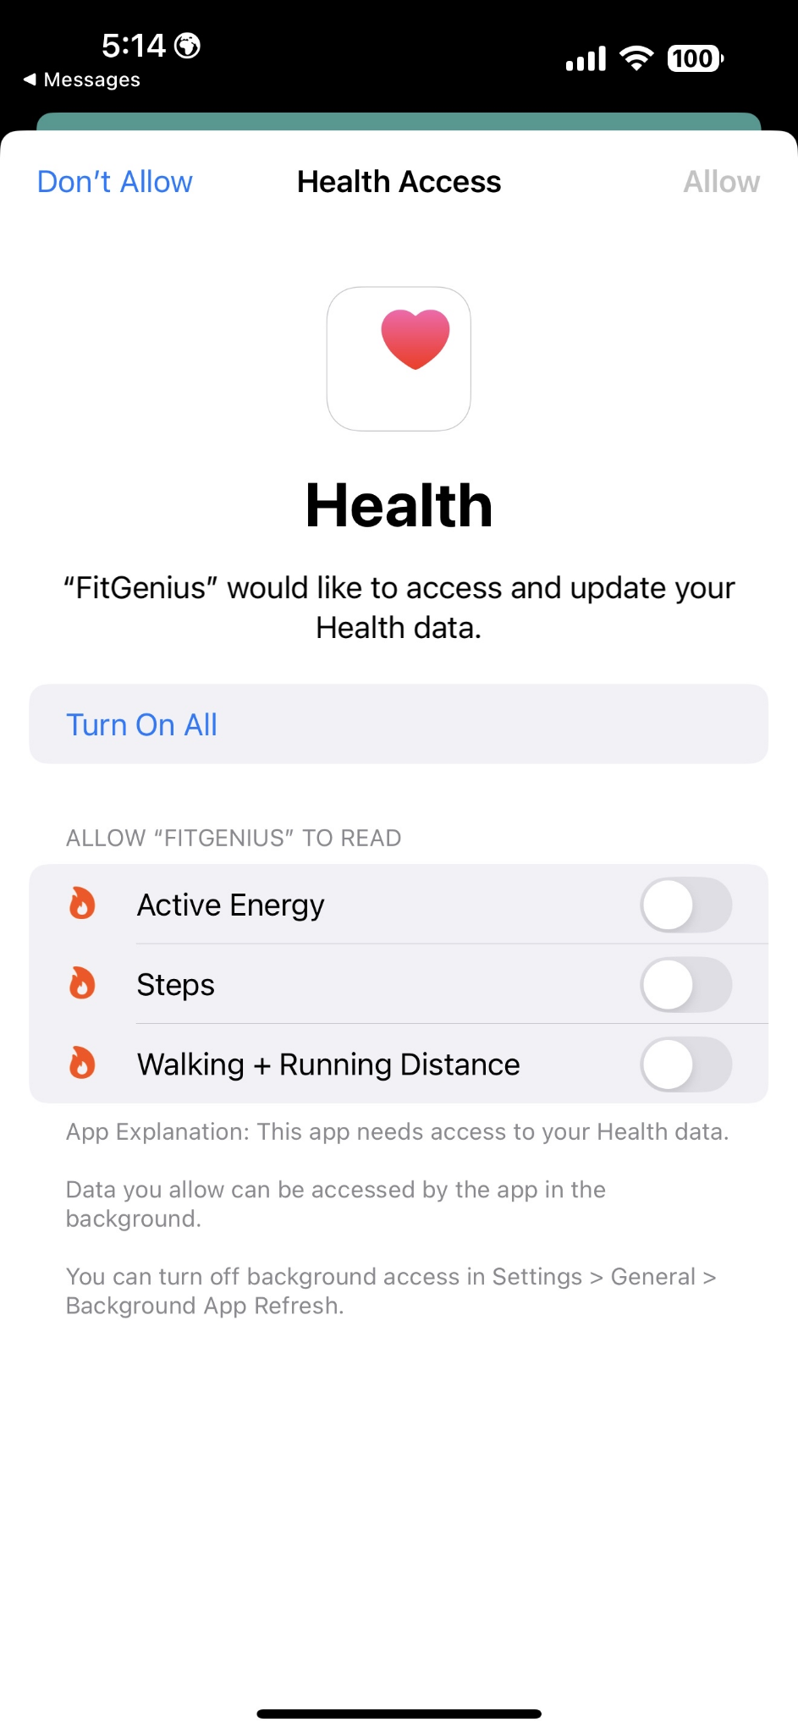
Health App Permission Access

Slide 23
Thanks!
Team #3
Project Lead:
Sergio Garcia
Team Members:
Emanuel Diaz
Mirna Farahat
Arpa Hakopian
Isai Flores

